Slide 1
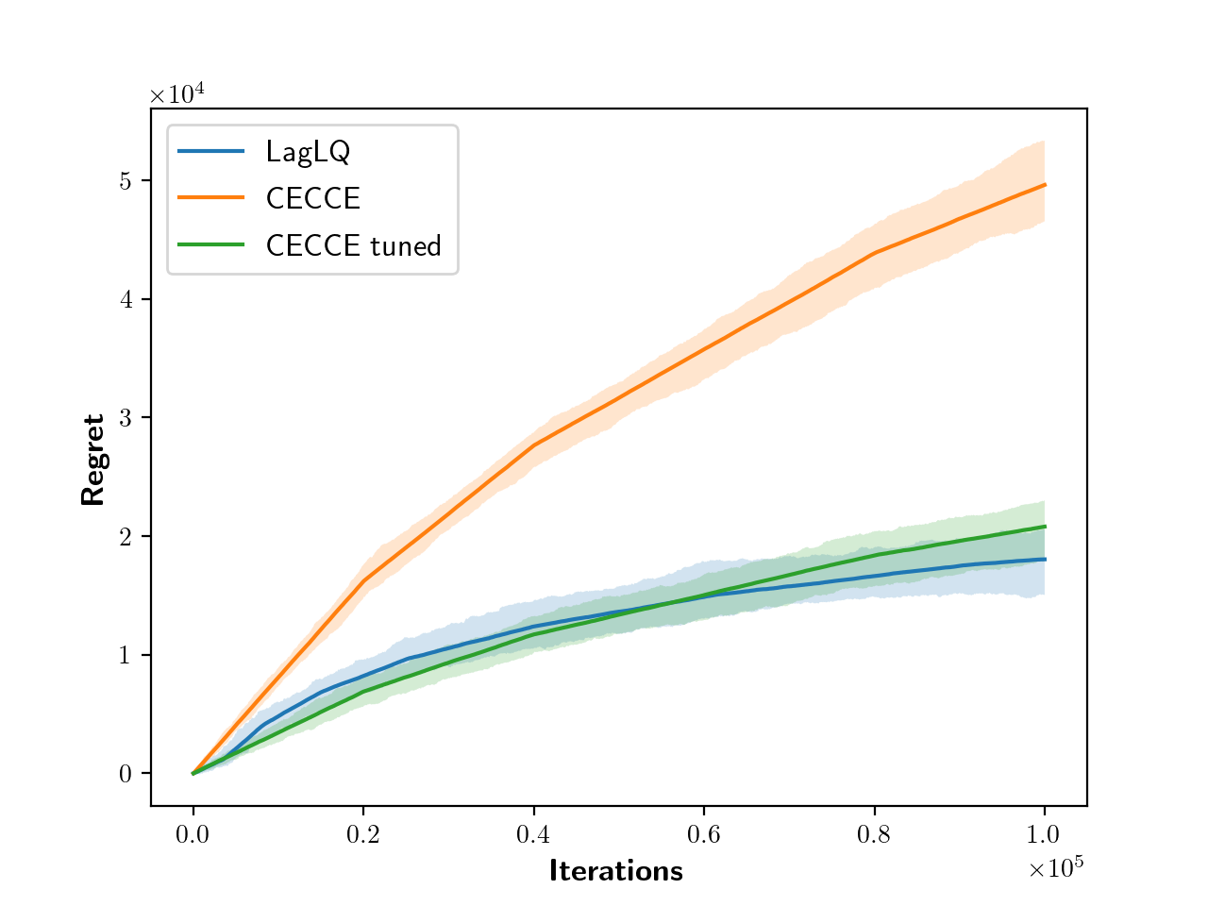
Relaxed optimistic optimization 16
• The research focuses on solving the optimistic LQR problem
• The approach uses extended value iteration (EVI)
• The method provides explicit computational complexity and eO(√T) regret guarantees
• Current systems are susceptible to exploitation, presenting a significant constraint
• The study addresses the challenges of applying existing methods to Large Language Models (LLMs)

Slide 2
Solve optimistic lqr explicit
• The research focuses on solving optimistic LQR problems
• The approach utilizes extended value iteration (EVI)
• The algorithm aims to return an ϵ-optimistic and ϵ-feasible policy
• The algorithm is designed to avoid over-exploration by considering cost sensitivity
• The optimization in (16) maintains the learning guarantees of the original OFU-LQ algorithm

Slide 3
Propose relax optimistic optimization
• The document discusses solving the optimistic LQR problem with explicit computational complexity and eO(√T) regret guarantees
• The approach is inspired by extended value iteration (EVI)
• The document addresses the susceptibility of current systems to exploitation and potential hallucination issues
• Computational requirements for training LLMs, which involve millions or billions of parameters, are discussed
• The optimization process preserves the learning guarantees of the original OFU-LQ algorithm

Slide 4
Lqr lagrangian relaxation introduce
• The document introduces a Lagrangian formulation to solve constrained Linear-Quadratic Regulator (LQR) problems
• The approach provides an efficient optimistic exploration method, named LAGLQ, for LQR problems with explicit computational complexity and eO(√T) regret guarantees
• The method uses Lagrangian relaxation and solves at most O(log(1/ϵ)) Riccati equations to compute an ϵ-optimistic controller
• The approach addresses the limitations of existing optimistic LQR methods, improving efficiency and removing certain constraints
• The paper demonstrates strong duality and shows that the algorithm can provide a solution to the original problem at any accuracy level

Slide 5
Relax optimistic optimization ofu
• The document discusses optimistic LQR (Linear Quadratic Regulator) problems and their computational complexity
• The approach is inspired by extended value iteration (EVI)
• The research addresses the susceptibility of current systems to exploitation
• Training large language models (LLMs) requires substantial computational resources
• LLMs are limited in their ability to benefit from methods designed to improve other systems due to complexity

Slide 6
Efﬁcient optimistic exploration linear
• Over-exploration can occur when there's an asymmetry in cost sensitivity related to estimation error
• Optimistic LQR problems are addressed by methods like OFU-LQ++ and LAGLQ
• Large language models (LLMs) are experiencing rapid advancements due to deep learning, PLMs, extensive datasets, and hardware improvements
• A key challenge for current systems is their susceptibility to exploitation, affecting both language models (LMs) and knowledge graphs (KGs)
• The precision of LLMs in discerning true statements is improving

Slide 7
Lagrangian relaxation regret
• The document focuses on an efficient optimistic exploration method for Linear-Quadratic Regulators (LQR) using Lagrangian relaxation
• The method achieves an ϵ-optimistic and ϵ-feasible solution for constrained LQR
• The approach, named LAGLQ, is inspired by extended value iteration (EVI)
• LAGLQ provides eO(√T) regret guarantees, potentially outperforming the worst-case √T bound in some scenarios
• The solution involves a Lagrangian formulation and solving Riccati equations

Slide 8
Quadratic regulators lagrangian relaxation
• The document focuses on efficient optimistic exploration within the Linear-Quadratic Regulator (LQR) framework
• The core approach involves using Lagrangian relaxation to solve a constrained LQR problem
• The method offers an efficient and optimal confidence-based algorithm for LQR, with computational advantages
• The algorithm, named LAGLQ (Lagrangian-LQ), achieves regret guarantees related to the length of the initial phase and ϵ-optimality
• The approach leverages optimistic extended controllers and addresses challenges related to non-convexity in the optimization problem

Slide 9
Solve similar optimistic optimization
• The text discusses solving the optimistic LQR problem with computational complexity and regret guarantees
• The approach is inspired by extended value iteration (EVI)
• The text touches on the susceptibility of current systems to exploitation and the importance of fine-tuning for specific tasks
• Optimization preserves learning guarantees of the original OFU-LQ algorithm
• Large Language Models (LLMs) don't benefit from methods due to their complexity and inaccessibility of architecture and parameter space

Slide 10
Optimistic controllers generated solving
• The text addresses the optimistic LQR problem, offering explicit computational complexity and regret guarantees
• The approach is inspired by extended value iteration (EVI)
• A significant constraint of current systems is their susceptibility to exploitation
• LLMs may struggle with these methods due to architectural complexity
• The text also touches upon code completion and program synthesis, suggesting their utility in software development

Slide 11
• Large Language Models (LLMs) are complex, making it difficult to apply traditional methods for performance improvement
• LLMs are susceptible to exploitation and can produce incorrect or fabricated information (hallucination)
• Training LLMs requires significant computational resources due to the large number of parameters and the need for extensive datasets
• Optimistic controllers are introduced for Linear Quadratic Regulator (LQR) problems, but their practical application faces computational challenges
• The text touches upon the need to address bias and ethical concerns in LLM development
Formulation solution optimistic controller

Slide 12
Relax optimistic optimization
• The research focuses on solving optimistic LQR problems with explicit computational complexity and regret guarantees
• The approach is inspired by extended value iteration (EVI) and utilizes optimistic extended controllers
• Current systems are susceptible to exploitation
• Training LLMs, involving millions or billions of parameters, presents significant computational requirements
• The optimization process preserves learning guarantees

Slide 13
Duality result optimistic controller
• Current language models (LLMs) are susceptible to exploitation and prone to "hallucination
• "
• The precision of LLMs in discerning true statements is improving
• LLMs do not currently benefit from methods due to architectural complexity and inaccessibility
• Training LLMs requires significant computational resources due to the large number of parameters

Slide 14
Lqr efﬁcient optimistic exploration
• The text focuses on solving the optimistic LQR problem with explicit computational complexity and regret guarantees
• The approach is inspired by extended value iteration (EVI) and aims to provide tight regret guarantees
• The text discusses the performance of confidence-based exploration strategies, including OFU-LQ++ and LAGLQ
• A key challenge addressed is the potential for over-exploration and its impact on regret bounds
• The research also touches on the use of Large Language Models (LLMs) for specialized tasks, mentioning applications and limitations like hallucination

Slide 15
Optimistic optimization 16 lagrangian
• The paper introduces an efficient, optimistic, confidence-based algorithm (LAGLQ) for Linear-Quadratic Regulators (LQR)
• LAGLQ is based on Lagrangian relaxation of the extended LQR problem
• The algorithm provides eO(√T) regret guarantees
• An ϵ-optimistic controller can be efficiently computed by solving at most O(log(1/ϵ)) algebraic Riccati equations
• LAGLQ leverages Dual Search-OFU (DS-OFU) within the OFU-LQ++ learning scheme

Slide 16
Relaxed optimistic optimization
• The text focuses on solving the optimistic LQR (Linear Quadratic Regulator) problem
• The approach uses an extended value iteration (EVI) method
• The method provides explicit computational complexity and eO(√T) regret guarantees
• The research relates to addressing the susceptibility of current systems to exploitation, specifically within the context of language models (LLMs)
• LLMs' complexities and inaccessibility of their architecture and parameter space make it hard to apply certain methods

Slide 17
Regulators lagrangian relaxation regret
• Here's a summary of the text in concise bullet points:
• The paper introduces a Lagrangian relaxation approach for efficient optimistic exploration in Linear-Quadratic Regulators (LQR)
• The proposed algorithm, LAGLQ, achieves sublinear regret, potentially outperforming worst-case bounds by adapting to problem structure
• The method involves solving a constrained LQR problem, for which strong duality is proven
• An epsilon-optimistic and epsilon-feasible solution is computed efficiently by solving a Riccati-based algorithm

Slide 18
Optimistic optimization ofu lq
• The research focuses on optimizing the OFU-LQ algorithm to maintain learning guarantees while addressing computational complexity
• The extended value iteration (EVI) approach is utilized to solve optimistic LQR problems
• The algorithm addresses over-exploration issues related to cost sensitivity estimation errors
• The work discusses the use of relaxed versions of the original OFU-LQ++ problem to obtain optimistic solutions
• A significant constraint of current systems is their susceptibility to "hallucination"

Slide 19
Duality relaxed optimistic optimization
• Current systems are susceptible to exploitation, requiring further examination
• The precision of Language Models (LLMs) in discerning true statements can potentially be improved
• LLMs don't currently benefit from certain optimization methods due to their complex architectures
• Training LLMs involves processing millions or billions of parameters, leading to significant computational requirements
• Optimistic extended controllers can induce fiable claims

Slide 20
Optimistic exploration linear quadratic
• The research focuses on solving the optimistic LQR problem
• The approach is inspired by the extended value iteration (EVI) algorithm
• The method aims to address the exploration-exploitation dilemma in the linear quadratic regulator (LQR) setting
• The algorithm leverages asymmetry from the confidence set to avoid over-exploration in certain directions
• The research discusses limitations, such as susceptibility to exploitation and the potential for "hallucination" in current systems

